Slide 1
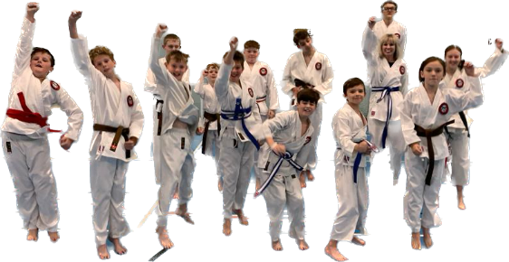
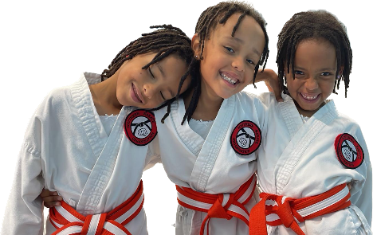
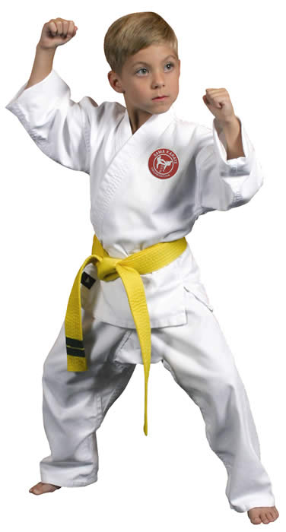
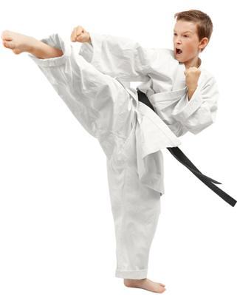
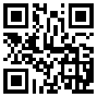
NON CONTACT KARATE TAUGHT BY fully QUALIFIED INSTRUCTORS
EVERYONE WELCOME
FROM 4 YEARS OLD
WE TEACH TRADITIONAL KARATE ENCOURAGING CONFIDENCE, RESPECT, DISCIPLINE, SELF AWARENESS AND AGILITY IN A FUN & CONTROLLED ENVIRONMENT. All classes are friendly, informative & cater to the individual needs of the student.
BEECHWOOD JUNIORS
THURSDAYS 3.30PM – 4.30PM
£6.00 PER CLASS – pay as you go
membership required after first class £25 per year
MANY MORE CLASSES TO CHOOSE FROM, FIND THEM ALL AT: WWW.SOUTHERNKARATE.ORG
FOR MORE INFORMATION AND TO BOOK YOUR PLACE
EMAIL: info@southernkarate.org
Tel: 07764 478507

