Slide 1
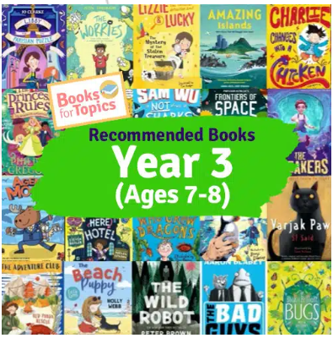
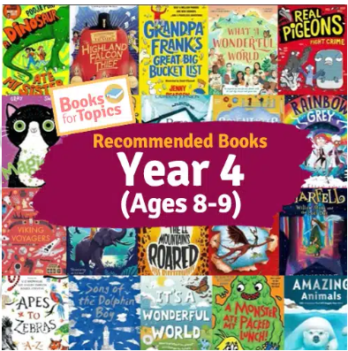
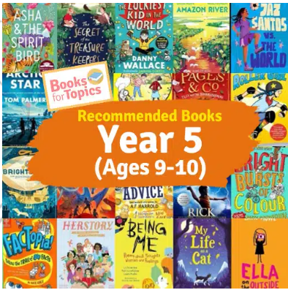
Reading List Challenge
Take a checklist for your year group and try reading some books from the list. If you manage to read any from the list, tick them off. If you manage 3 from the list, let your teacher know and you will earn a certificate and entry into a prize draw. If you read another 3, you will earn another certificate and entry (and so on). Enjoy!

